Slide 1
VERSION CONTROL

Slide 2
https://happygitwithr.com/

Slide 3

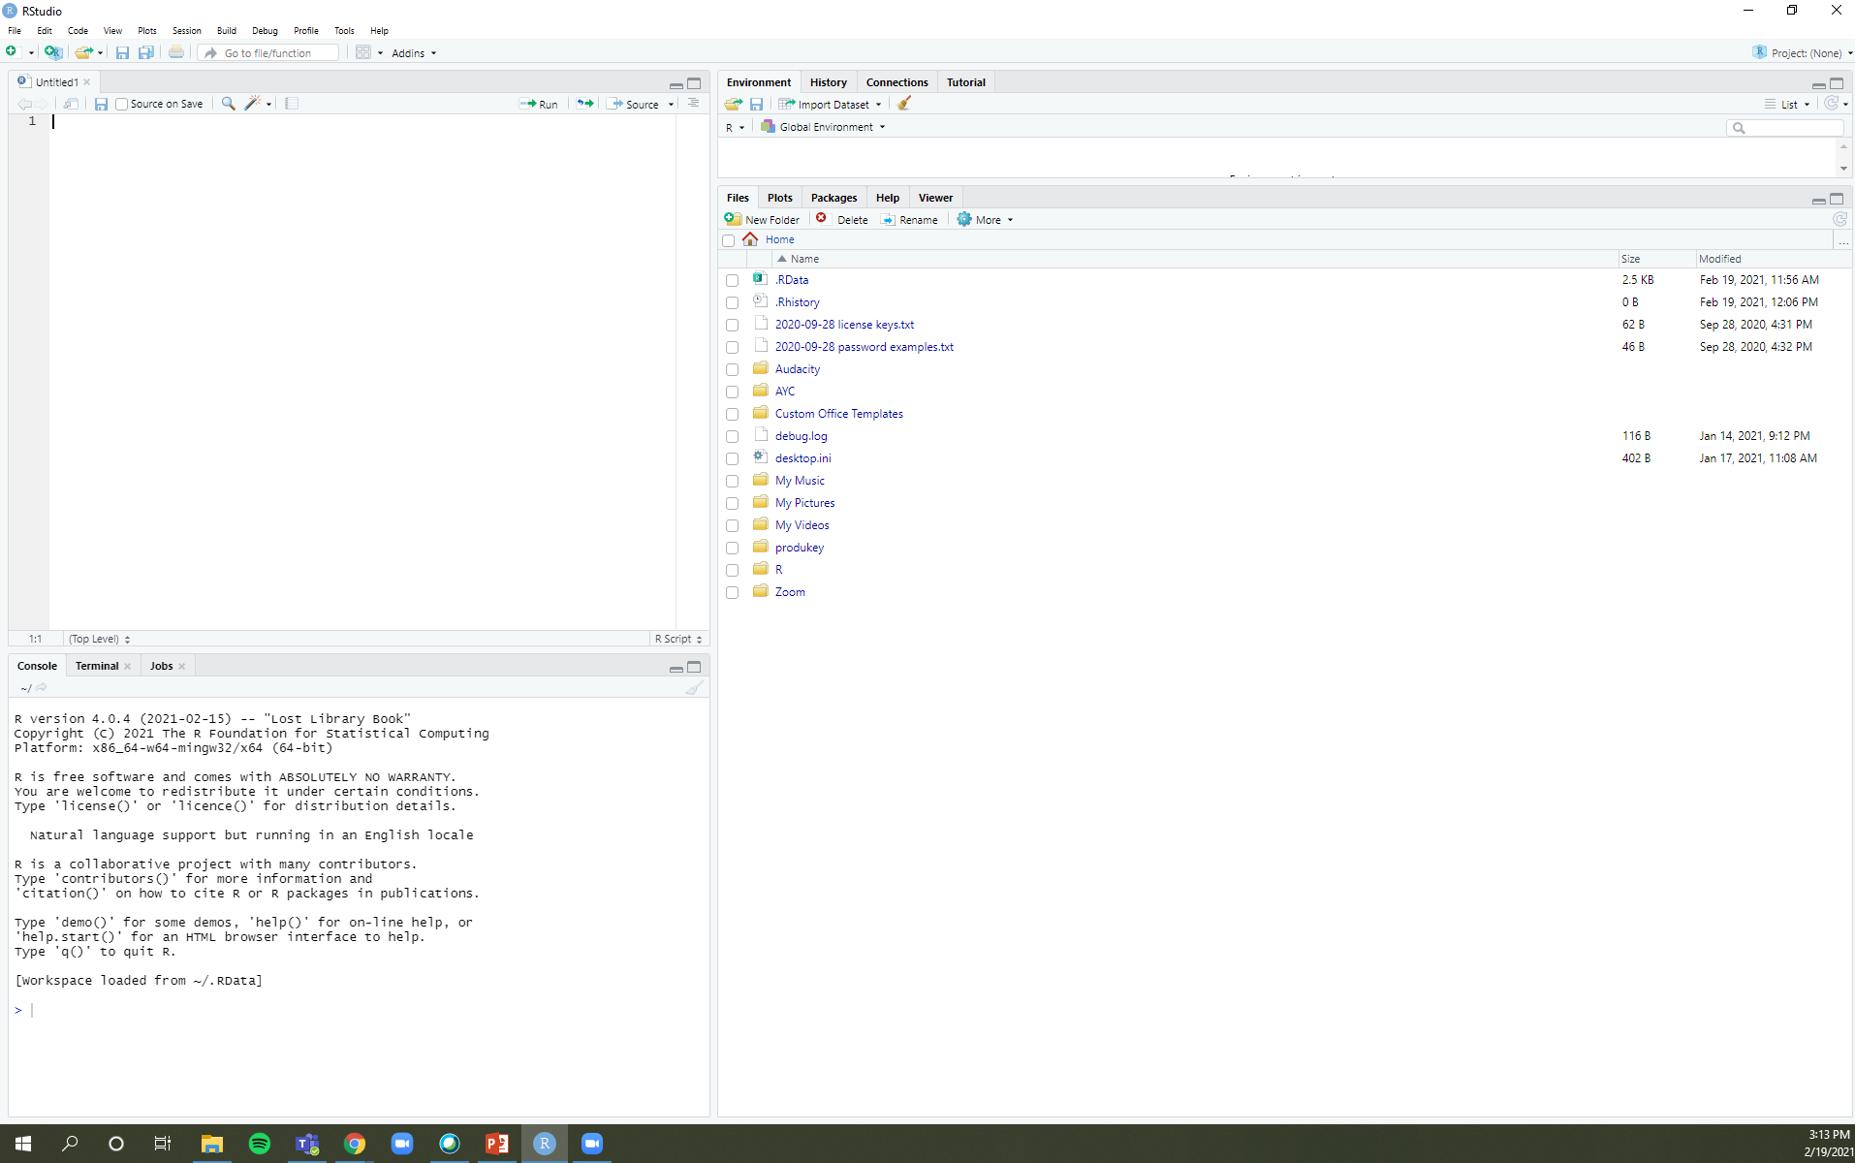
What you want to do
R script (like a .do file)

Slide 4
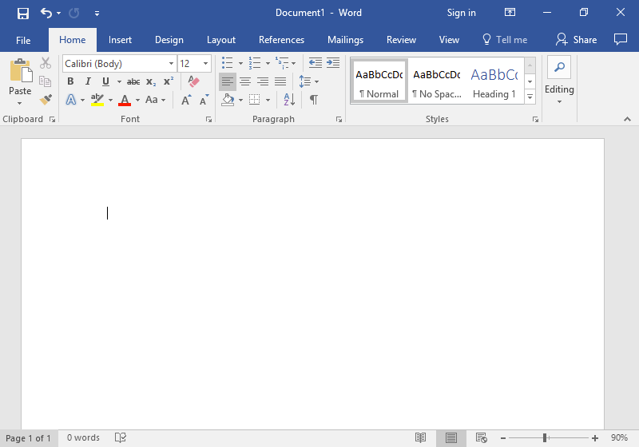

Writing it out
R Markdown
Notes:
Markdown is a plain text file (often a word document, .pdf, or webpage) that captures the code, documentation of what the code does, and the code’s output.

Slide 5
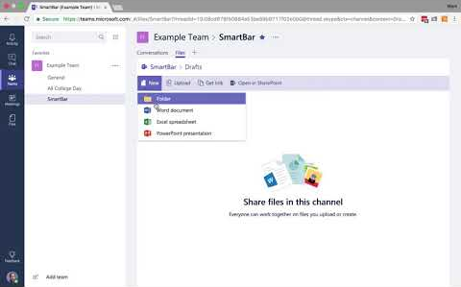
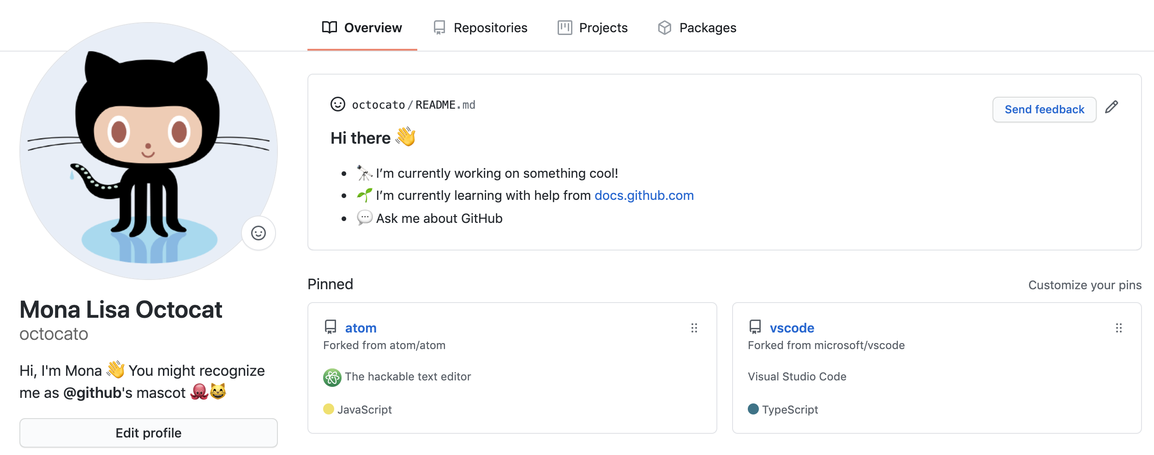
Git vs GitHub
Saving & Collaborating
GitHub
Notes:
Git is a version control system that manages various drafts of various files. (think Track Changes, but with descriptions for each draft or Revise & Resubmit)
There are a lot of web-based hosting services like GitHub, Bitbucket, and GitLab. They provide a home, clearinghouse, or distribution channel for your Git-based projects on the internet. It allows other people to see your stuff, sync up with you, and perhaps even make changes. (think OneDrive, Google Drive, Dropbox, Box)

Slide 6
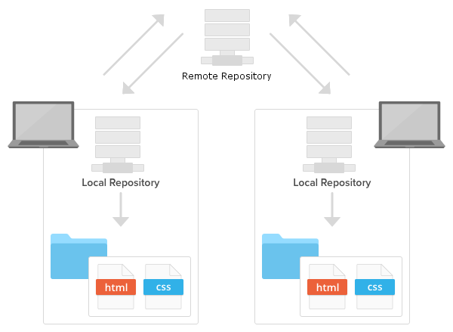
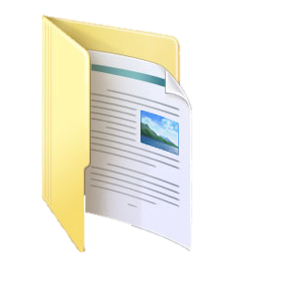
Organizing your projects
Saving to your repository
Notes:
A repository (or repo) is a set of files. (think of your Documents folder on your local computer)

Slide 7
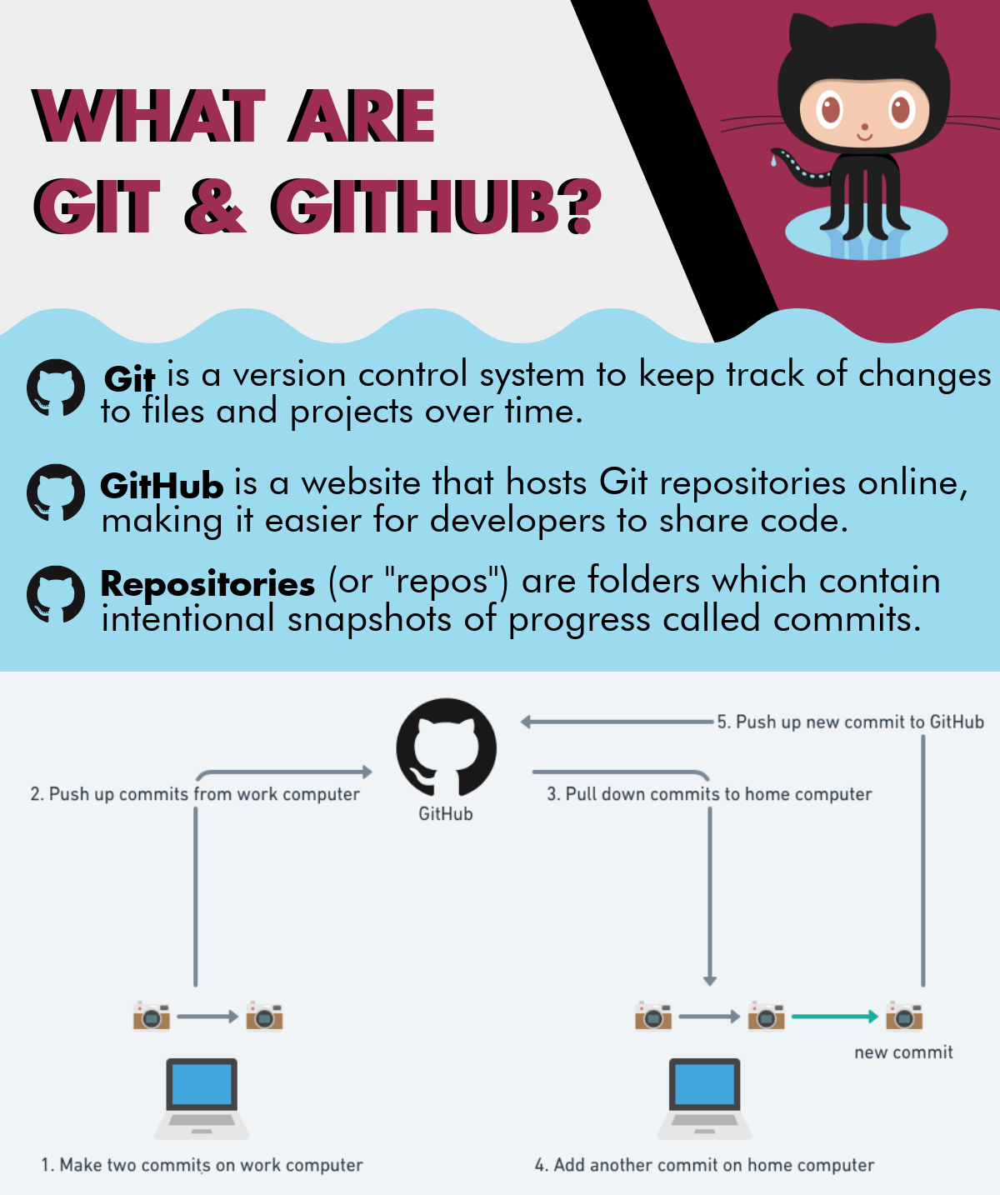

Slide 8
Pull down changes (like from a cloud)

Slide 9
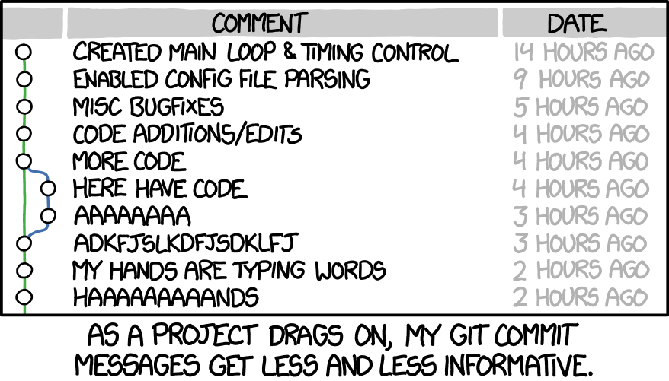
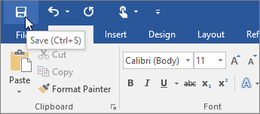
Save your changes
Commit your changes

Slide 10
Push your local commits to GitHub

Slide 11
How do I do this?
R & RStudio

Slide 12

Git
Download & Install: https://git-scm.com/downloads
Sign up for / sign in to your account: https://github.com/
Create a new / find the URL to an existing repository (e.g., https://github.com/user-name/repo-name.git)
Add a ReadMe (think instruction manual or recipe)
Add a license (any will do)

Slide 13
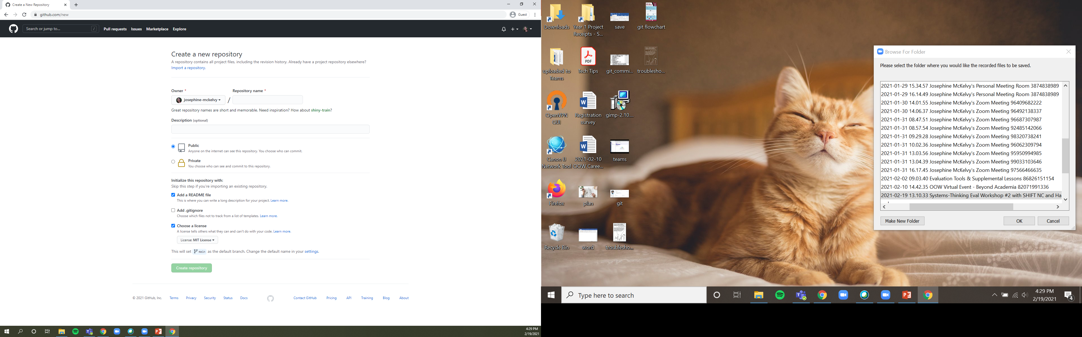
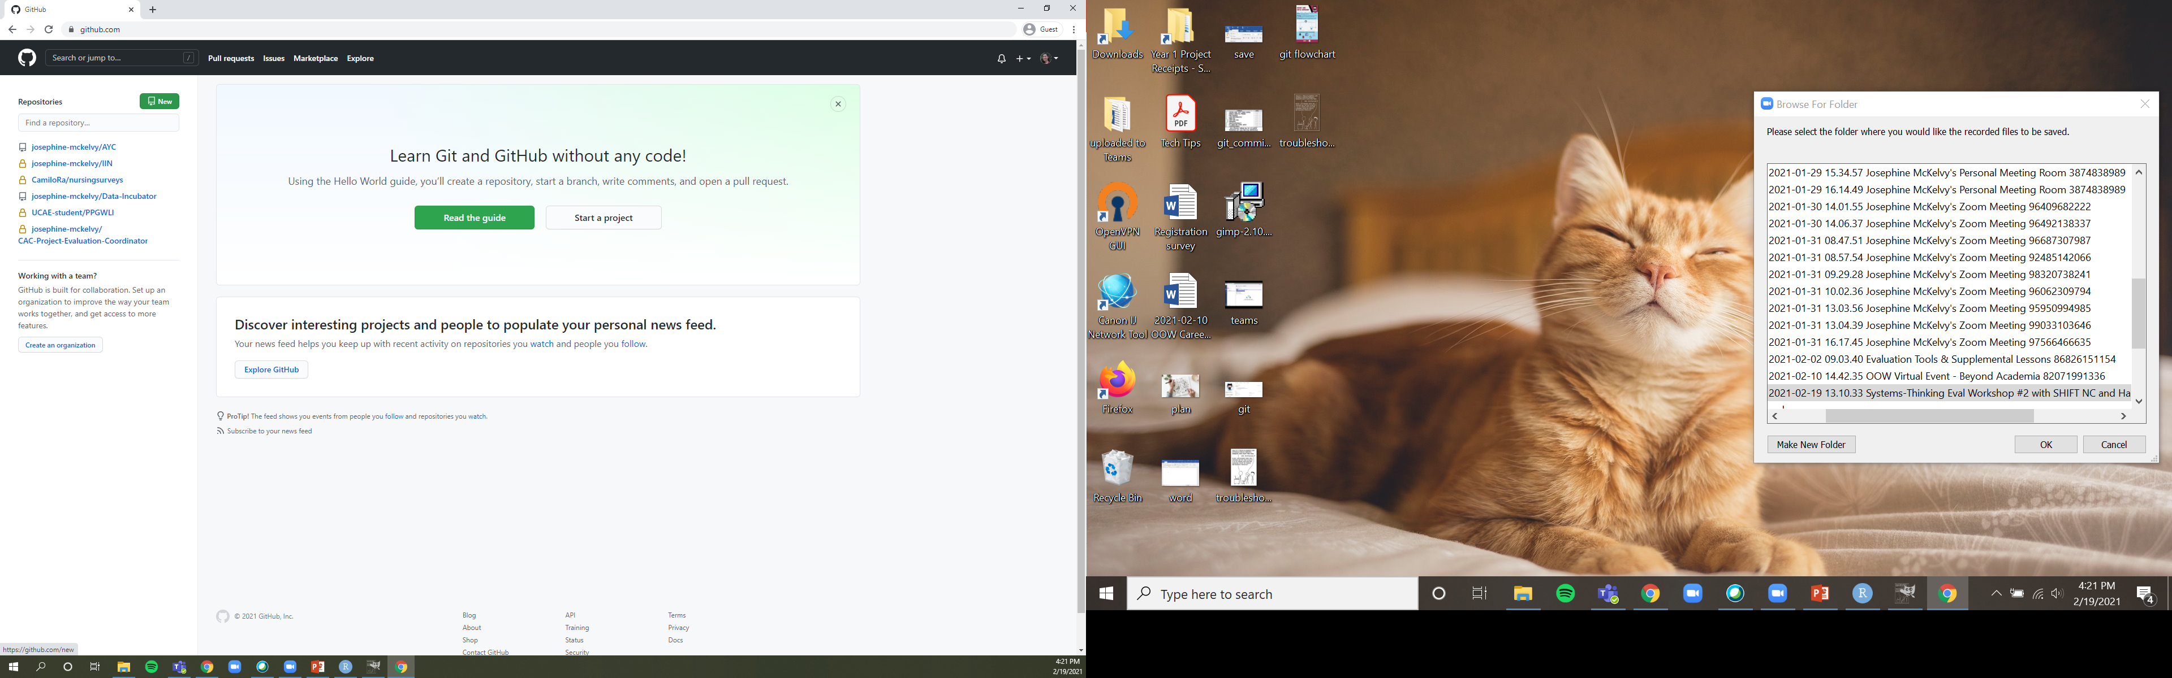

Slide 14


R vs RStudio
R is the coding language.
Download & Install: e.g., https://archive.linux.duke.edu/cran/
CRAN, or the Comprehensive R Archive Network, is a set of identical or mirror websites that hosts R for you to download. Downloading from the mirror closest to your location reduces internet traffic.
RStudio is an IDE (Integrated Development Environment), or the software application that helps you (the user) interface with the text editors, code libraries, compilers, and other tools you’ll use.
Download & Install: https://rstudio.com/products/rstudio/download/#download
Run RStudio
Create a new project

Slide 15
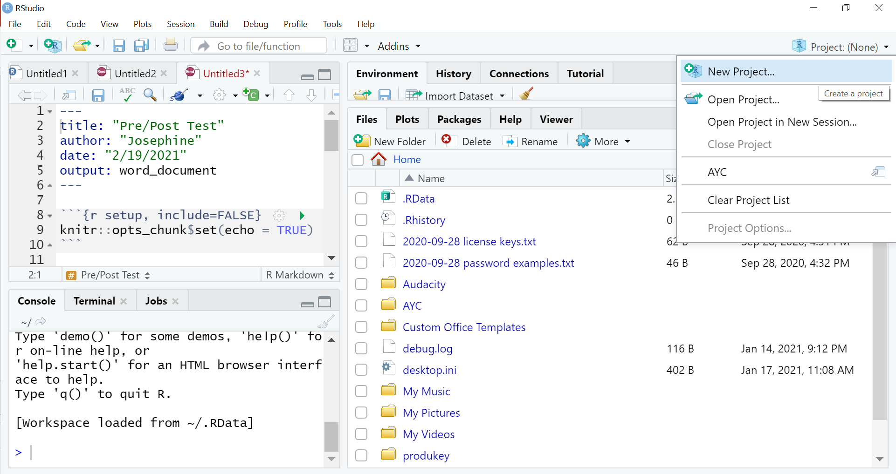

Slide 16
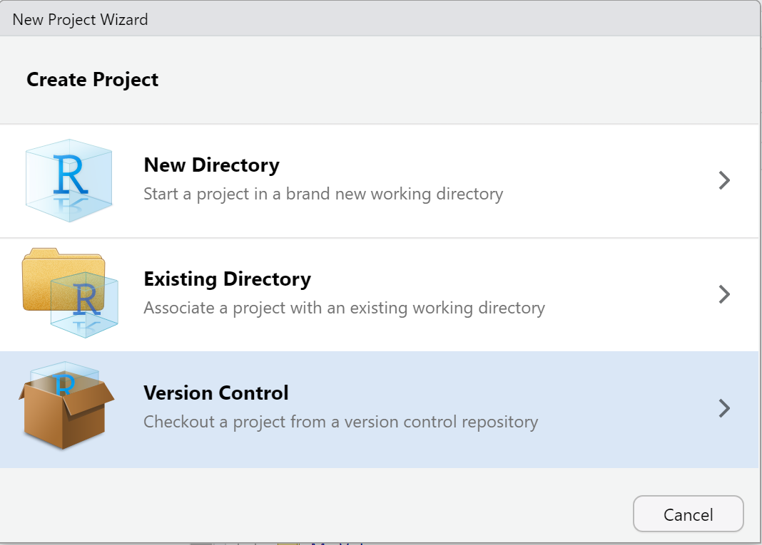

Slide 17
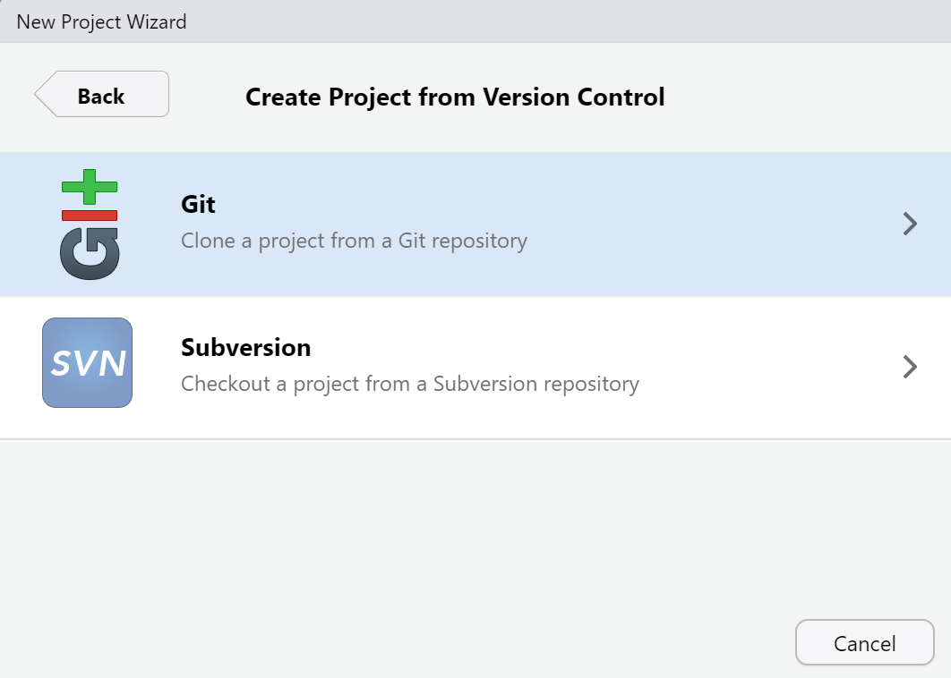

Slide 18
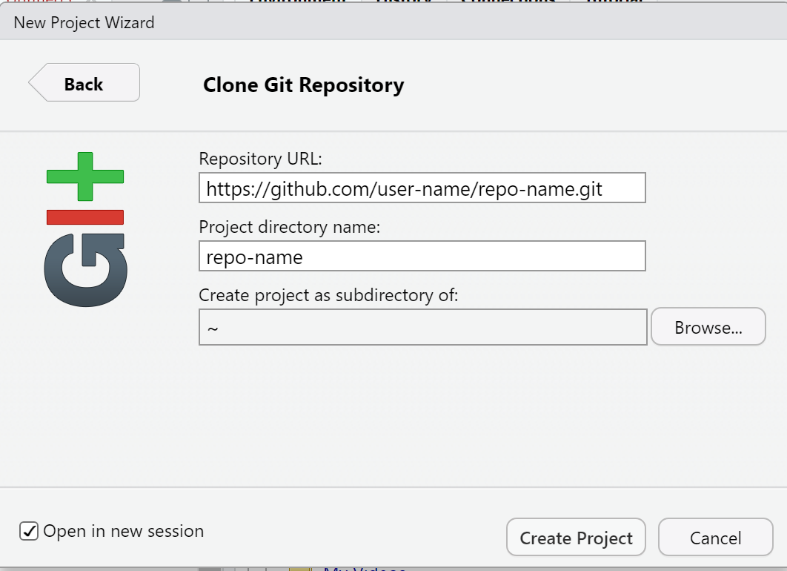

Slide 19


